Slide 1

ECONOMIC AND DEMOGRAPHIC TRENDS ANALYSIS
DEVADHARSHINI
DA&DS

Slide 2

Project Overview
The project will provide a comprehensive analysis of the economic and demographic changes that have shaped the global landscape over the last several decades. It will also offer actionable insights, such as potential future trends or areas where policy or investment might be needed.
Data Source
Excel
SQL
Statistics
Power Bi

Slide 3
Data Cleaning
Replaced null values as Zero’s.
Removed Duplicate Rows.
Removed Blank Rows and Columns.
Appended GDP dataset.
Unpivoted Years and values.

Slide 4
Statistics
Population Data
GDP Analysis
Infant Mortality
Literacy Rates
Growth Trends

Slide 5
DAX Function
population growth rate over time
GDP growth rate.
calculated columns for GDP per capita.
Aggregating population or GDP data by region
Deriving insights such as the correlation between literacy rates and GDP.

Slide 6
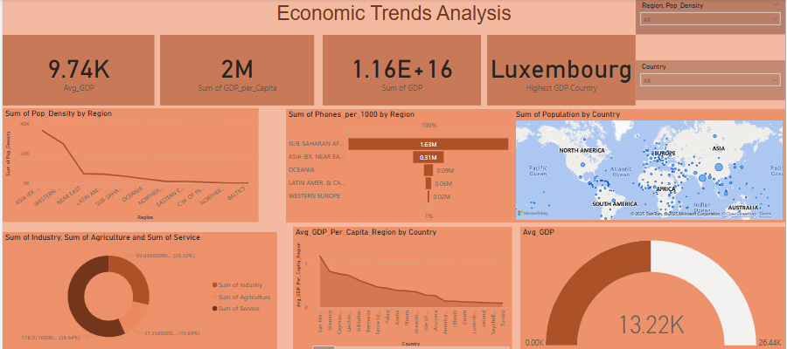
Dashboard

Slide 7
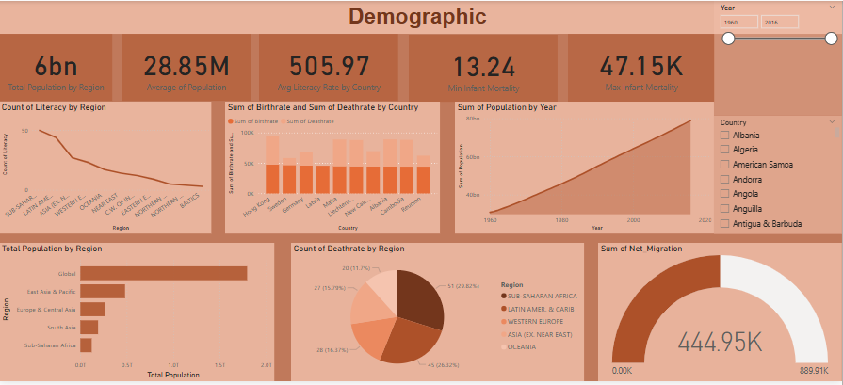
Dashboard

Slide 8
Insights
Asia has the highest population density, followed by Western Europe and the Near East.
Baltics and Northern regions have the lowest density, likely due to geography and climate.
High population density regions may face more challenges in urbanization and infrastructure.
Industry has the largest share, followed by the service sector.
Agriculture has the lowest contribution, indicating a global trend toward industrialization and services over traditional farming.

Slide 9
Recommendations
Promote policies that foster industrialization and service-sector growth in regions with lower GDP contributions.
Implement progressive taxation and wealth redistribution policies to reduce economic gaps.
Provide affordable internet access to enhance digital inclusion and economic participation.
Invest in maternal and child healthcare services in countries with high infant mortality rates.
Ensure urban centers have adequate infrastructure to accommodate migrants.
Implement policies to protect coastal regions with high climate sensitivity.

Slide 10
THANK YOU

